Slide 1


| Tech Management, SRI-B
CLAWS
CLASH OF THE
RVCE_Hacktivators
ATLAS - AI Training Advisor
Rohan S,
Rishab Rajesh Nayak,
Sandesh S Patrot
Lalan P

Slide 2
Idea
Problem Statement
Theme : GenAI Research
Retail crypto traders lose money not because markets are irrational — but because they are. Fear, greed, and information overload cause 80%+ of retail traders to underperform the market. Who Faces It (Persona): A college student trading ETH on Binance with ₹20,000 — no risk management, no strategy, pure gut feeling.
A part-time crypto investor who can't monitor charts 24/7 but doesn't trust a black-box bot either.
Why It's Important: Crypto markets are 24/7, volatile, and unforgiving.
Existing bots are either too simple (rule-based) or too opaque (black box ML).
Traders need a system that explains its reasoning, not just fires orders.

Slide 3
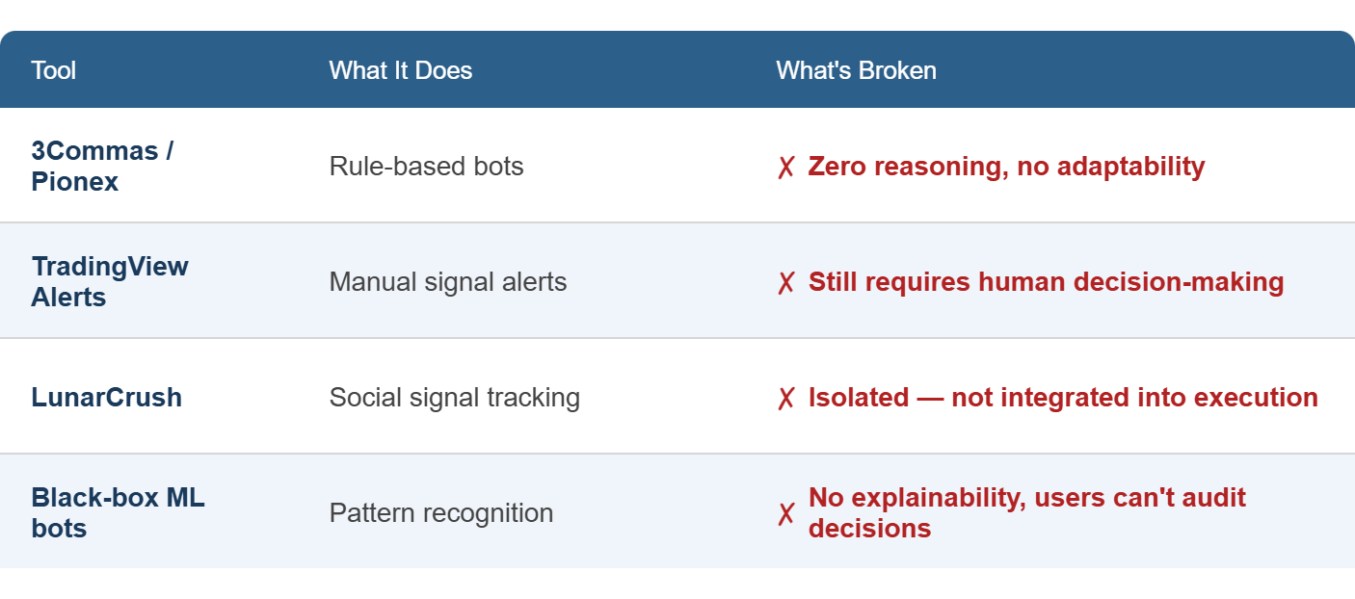
Idea
Current Solution & Gaps
What's Missing:
No tool combines technical + sentiment + risk + contrarian skepticism in one unified, explainable system.
No tool shows why it made a decision in plain English.
No tool learns from its own past mistakes and updates strategy automatically.

Slide 4
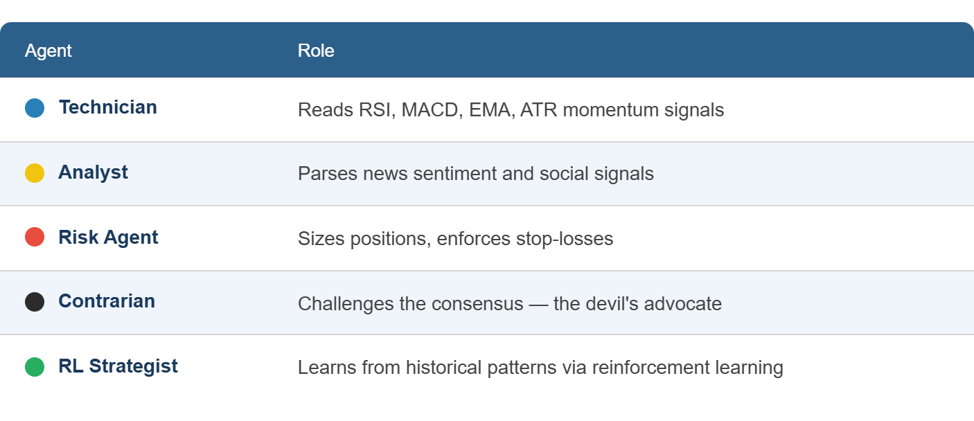
Idea
Your Solutions
What We Built: ATLAS — an Autonomous Trading Logic & Advisory System powered by a 5-Agent AI Consensus Engine for ETH/USD crypto markets.
Core Idea: Every 30 seconds, 5 specialized AI agents independently analyze the market and vote on a trade. A trade only executes when the collective confidence score exceeds 5.0/10. Think of it as a Supreme Court for every trade decision.
Key Features:
Live Voting Logs — see each agent's vote and reasoning in real time
Circuit Breaker — auto-halts trading during extreme volatility
HERMES Memory Agent — post-mortems every day; bakes learnings back into agent prompts

Slide 5
Idea
Your Solutions
The 5-Agent Consensus Pipeline
The heart of the demonstration is the real-time deliberation between five specialized AI agents:
The Technician: Focuses on mathematical indicators like Relative Strength Index(RSI) , Moving Average Convergence Divergence(MACD) , and Exponential Moving Averages(EMAs).
The Analyst: Uses GPT-4o to ingest live news and social sentiment, gauging the "mood" of the market.
The Risk Agent: Acts as the gatekeeper, calculating optimal position sizing and stop-loss levels based on market volatility (ATR).
The Contrarian: A unique agent designed to challenge the majority, preventing "herd mentality" and identifying potential trend reversals.
The RL Strategist: A Reinforcement Learning model (PPO) that scans for deep, non-linear patterns in price action.
The HERMES Learning Engine
Unlike static bots, ATLAS features HERMES, an autonomous hindsight and memory agent. HERMES performs two critical functions:
Strategy Evolution: It reviews daily performance and adjusts the "Strategy DNA" (meta-weights) of the agents to adapt to changing market regimes.
Transparency: It generates comprehensive "Daily Market Reports" that explain the why behind the system's performance, providing human-readable insights.

Slide 6
Idea
Demo/Product Walkthrough
User Flow — Step by Step: Open Dashboard
See live ETH/USD price, regime label (BULL / BEAR / CHOP), and current portfolio state.
Watch the Agents Deliberate
Live Voting Panel shows each agent's signal score and one-line reasoning.
e.g., "Technician: RSI=72, overbought. Vote: SELL (8.2). Contrarian: Disagree — volume supports breakout. Vote: HOLD (5.1)."
Consensus Decision
Aggregated score shown. If > 7.0 → trade executes. If not → system waits.
User can trigger Emergency Halt at any time with one click.
HERMES Post-Mortem
End of day: HERMES generates a plain-English report — "Today's loss on the 14:30 trade was caused by the Analyst agent overweighting a false positive news signal. Adjusting sentiment weight for tomorrow."
Performance Audit
"Transformation Story" screen shows ATLAS's evolution — win rate, Sharpe ratio, drawdown over time.
Key Moments to Highlight in Demo:
The moment the Contrarian agent overrides a consensus and saves the portfolio
A Circuit Breaker firing during a simulated flash crash
HERMES generating a post-mortem report after a bad trade

Slide 7
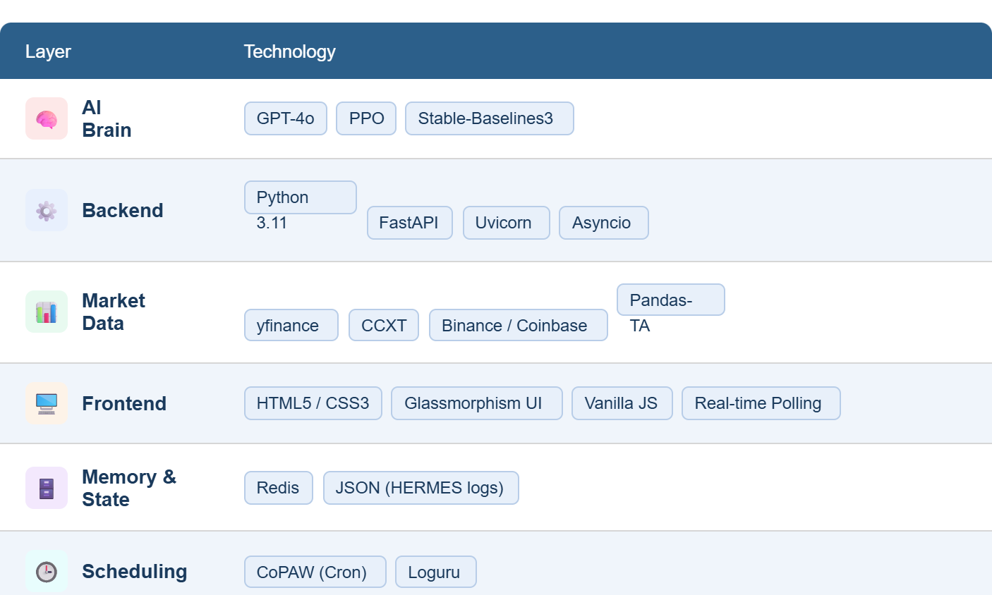
Idea
Tech & Architecture
AI Usage:
GPT-4o powers 4 of the 5 agents — each gets a specialized system prompt defining its persona and risk appetite.
PPO (Proximal Policy Optimization) trains the RL Strategist offline on 60-day historical data.
Agents communicate via an internal Consensus Aggregator that weights votes and fires execution commands.
System Flow (Simple):
Market Data (30s tick)
→ Technical Indicators (RSI, MACD, ATR, EMA)
→ 5 Agents analyze in parallel
→ Consensus Aggregator scores the round
→ Score > 7.0? Execute trade : Wait
→ HERMES logs result → updates agent DNA
→ Dashboard renders everything live

Slide 8
Idea
Impact & Use cases
Real-Life Scenarios:
The Student Trader A 21-year-old engineering student puts ₹15,000 into ETH. ATLAS runs in paper mode for 2 weeks, shows a simulated 12% gain with full reasoning logs. Student now understands why trades work — not just that they do.
The Busy Professional A software engineer can't watch charts during work hours. ATLAS monitors 24/7, fires alerts only when consensus is strong, and halts automatically if markets go haywire. No babysitting required.
The Skeptical Analyst A finance student wants to audit every decision. HERMES post-mortems give full attribution — which agent was right, which was wrong, and what changed. Full transparency, no black box. Scale Potential:
Extend to 50+ trading pairs across Binance, Coinbase, and Kraken via CCXT.
Add more agent personas (Macro Economist, On-chain Analyst).
White-label as a SaaS advisory tool for crypto funds and retail platforms.
Community layer: let users share and vote on Strategy DNA configurations.

Slide 9
Idea
Differentiation
Why ATLAS Stands Out:
MOAT 1 — Explainability by Design Every other trading bot is a black box. ATLAS makes every agent's reasoning visible in plain English, in real time. Users don't just see a trade — they see a debate. This builds trust and teaches users to think like a trader. No competitor offers this.
MOAT 2 — Self-Improving Memory (HERMES) ATLAS doesn't just trade — it learns. HERMES conducts daily post-mortems, identifies which agent reasoning was flawed, and updates the system's Strategy DNA. Over weeks, ATLAS becomes smarter specifically for the market conditions it has experienced. This compounding improvement is extremely hard to replicate quickly.
Bonus Differentiator — Democratic Consensus with a Skeptic Built In The Contrarian agent exists specifically to kill bad trades. Most systems optimize for action. ATLAS optimizes for correct action. The system is architecturally biased toward caution — which is exactly what retail traders need.

Slide 10
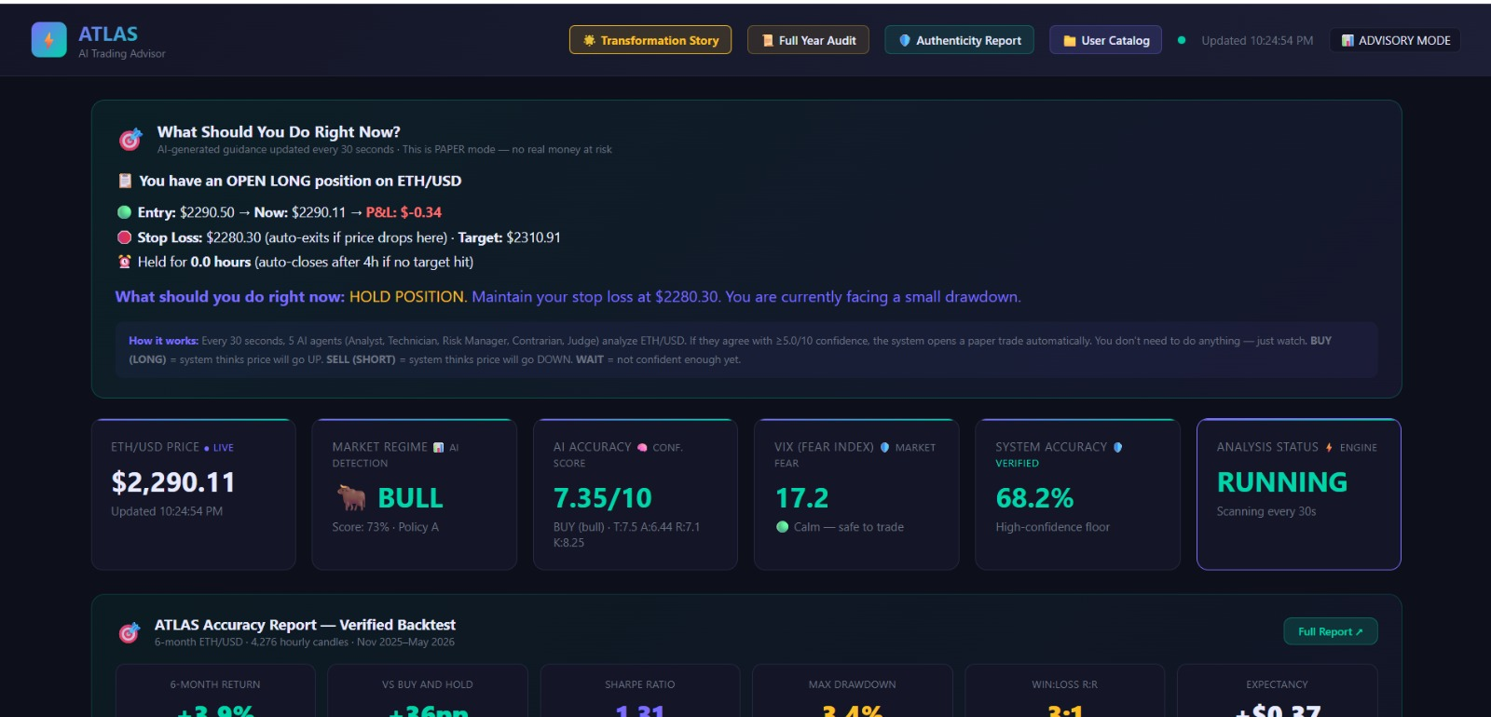
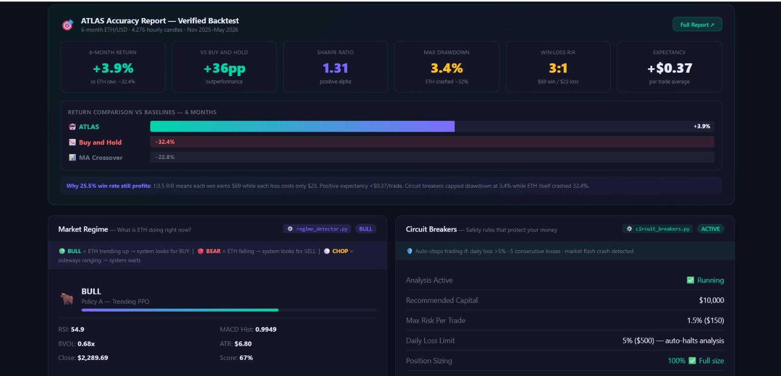
RESULTS

Slide 11
Idea
Demo Link
GitHub Repo - https://github.com/hihihi-svg/ATLAS Demo Link - https://drive.google.com/file/d/1dQHOMJPpKEpPHtKZmBmNMU25KjFZoAPy/view?usp=sharing Document submitted - https://docs.google.com/document/d/1XWGcT2da84ii2RsqHuhS2GlYhGltdpTb/edit

Slide 12
Idea
<Brownie Slide>
What's Next for ATLAS:
🔗 On-chain Integration — read wallet activity and DeFi signals as a 6th agent input
📱 Mobile Alerts — push notifications when consensus fires, with one-tap override
🧠 Fine-tuned Models — replace GPT-4o calls with a fine-tuned open-source model running on-device for zero-latency, zero-API-cost inference
🏆 Backtest Leaderboard — community can submit their own Strategy DNA configs and compete on Sharpe ratio over historical data
💬 Natural Language Queries — ask ATLAS "why did you sell at 3pm yesterday?" and get a full conversational breakdown

